Slide 1
ANALOG ELECTRONICS (EC-261) PROJECT
SUBMITTED BY : --- SUBMITTED TO :---
VARUN KUMAR (2K19-IT-140) M GANESH SIR
YASHIT KUMAR (2K19-IT-149)

Slide 2
MOBILE PHONE BATTERY CHARGER

Slide 3
OBJECTIVE
Nowadays mobile phones have become an integral part of everyone’s life and hence require frequent charging of battery owing to longer duration usage.
A mobile battery charger circuit is a device that can recharge a mobile phone’s battery when the power in it gets low.
Mobile phones generally charge with 5V regulated DC supply, so basically we are going to build a 5V regulated DC supply from 220 AC

Slide 4
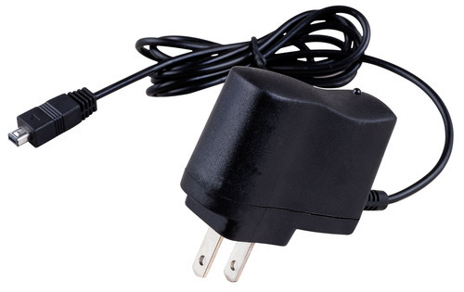

Slide 5
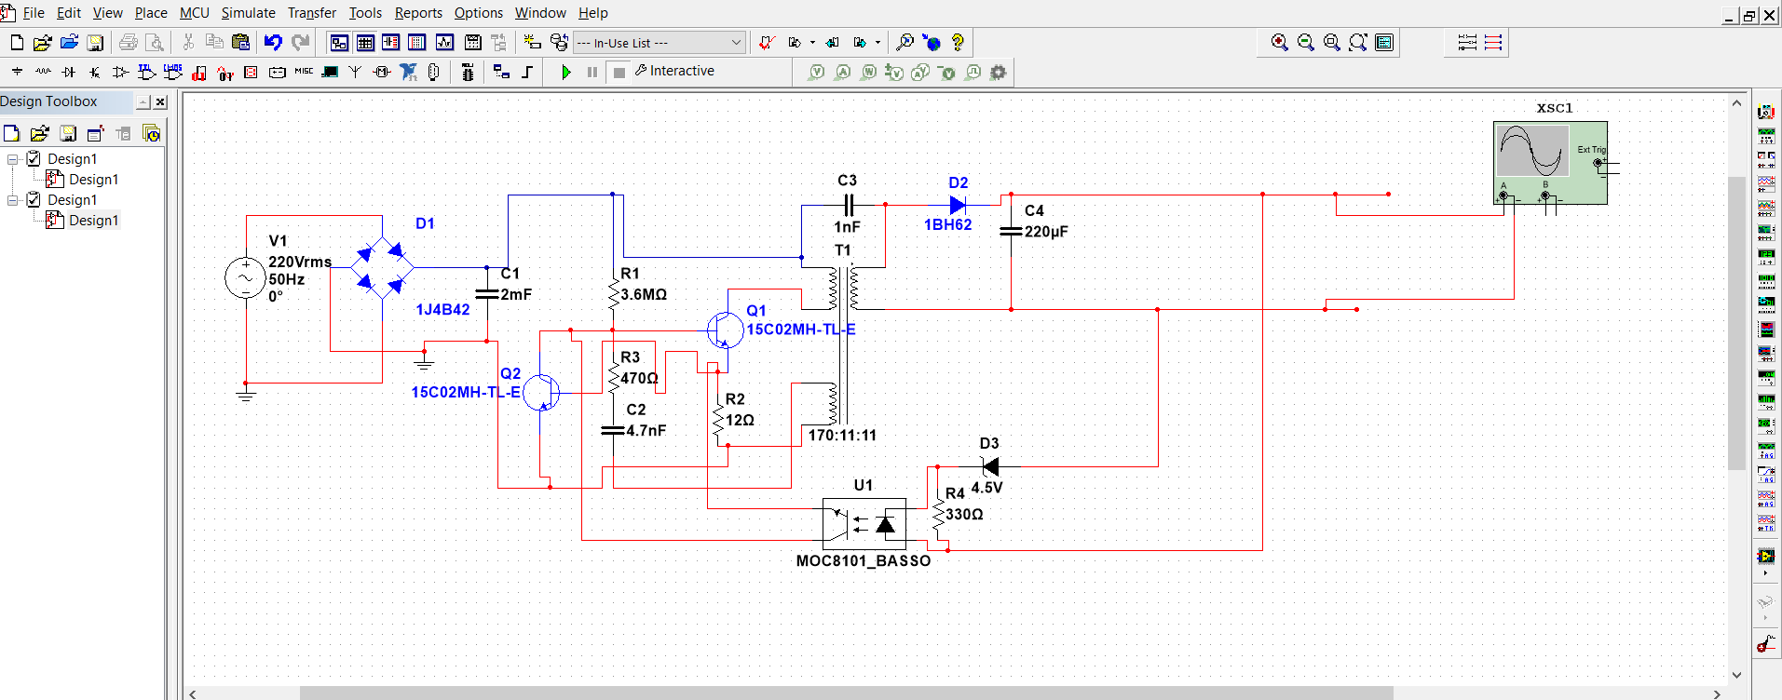

Slide 6
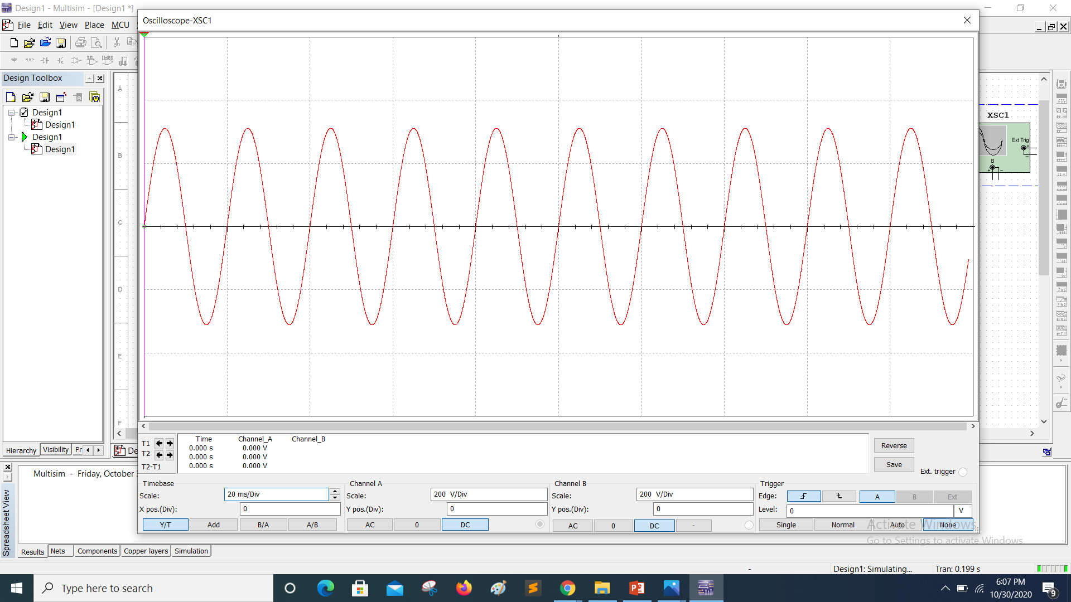
INPUT 220 V 50 Hz AC Voltage

Slide 7
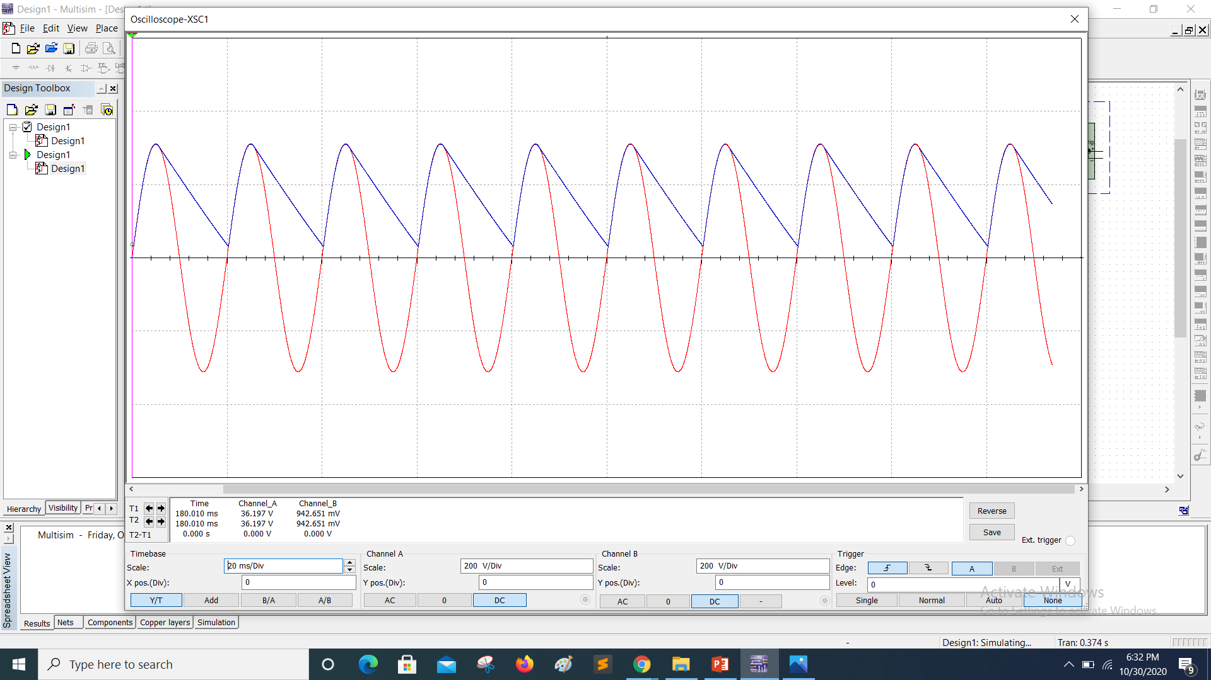

Slide 8


Slide 9
